Slide 1
DEEPFAKE DEFENSE SYSTEM
Presented by
Student name: P.Vigneshkumar
College name: Salem college of Engineering and Technology
Department: Computer science and Engineering

Slide 2
PROBLEM STATEMENT
Deepfake is a technology that can change faces of any objects which leads to misuse of people faces.

Slide 3
PROPOSED SYSTEM
Advanced detection algorithms and forensic
analysis tools are being developed to identify
and flag deepfake content.

Slide 4
SYSTEM DEVELOPMENT APPROACH
Collaboration between tech companies,media organizations,and research institutions is vital for developing and sharing tools and best pratices in the fight against deepfakes.

Slide 5
Algorithm and Deployment
Governments and tech companies must collaborates to establish regulatory frameworks for combating deepfakes.
These could include content authenticity standards and penalties for malicious use.

Slide 6
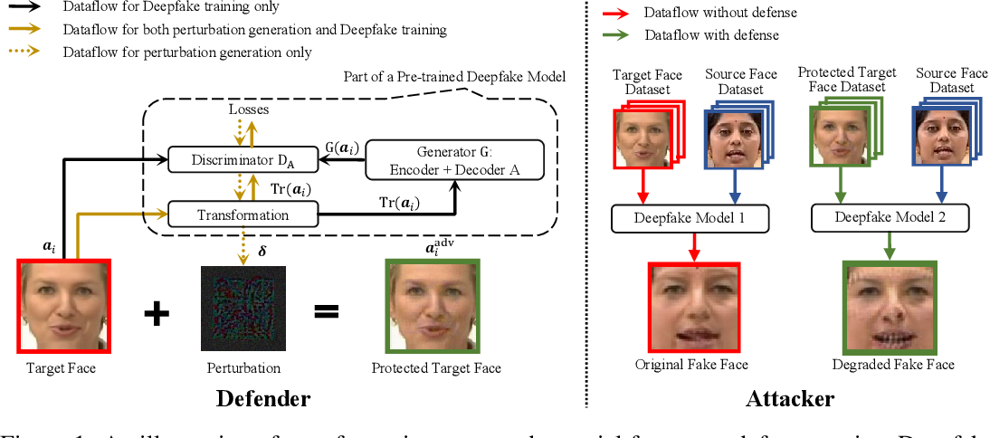
RESULT

Slide 7
CONCLUSION
Summarize the findings and discuss the effectiveness of the propose solution Highlight any challenges encountered during the implementation and potential improvements.

Slide 8
FUTURE SCOPE
The development in deepfake technology increases the threat of being misuse of images of people.
For better trust and authenticity deepfake defense system is the massive solution for over come these threats in future.

Slide 9
THANK YOU

